Slide 1
Link State Routing Simulator
Saba Ghauri
A20336256
CS542

Slide 2
Link state routing protocol
Link-state routing protocols are one of the two main classes of routing protocols used in packet switching networks for computer communications, the other being distance-vector routing protocols
Examples of link-state routing protocols include Open Shortest Path First (OSPF) and intermediate system to intermediate system (IS-IS

Slide 3
OSPF is an interior gateway protocol (IGP) for routing Internet Protocol (IP) packets solely within a single routing domain, such as an autonomous system
It gathers link state information from available routers and constructs a topology map of the network
The topology is presented as a routing table to the Internet layer which routes packets based solely on their destination IP address

Slide 4
Screenshots of project

Slide 5
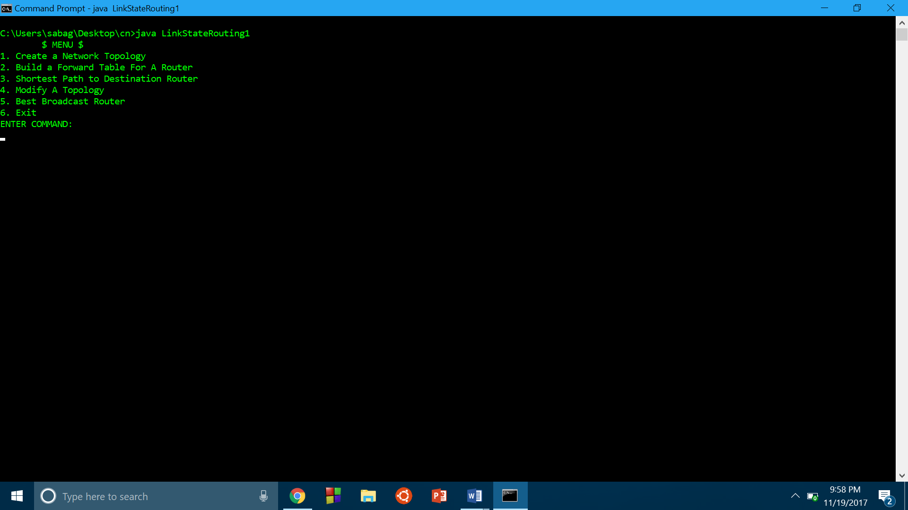
The main menu

Slide 6
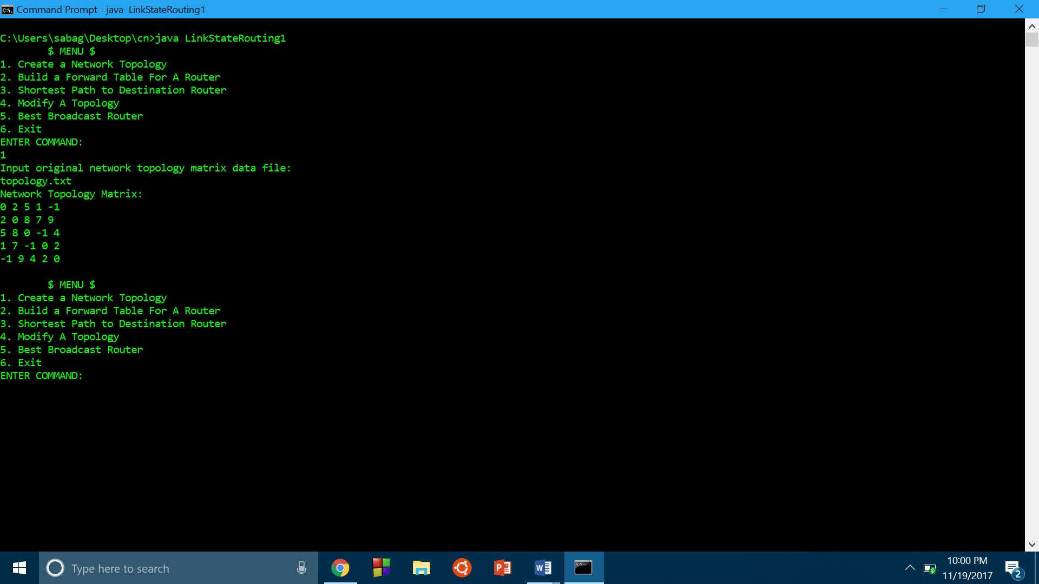
Take users input and displays adjacency matrix

Slide 7
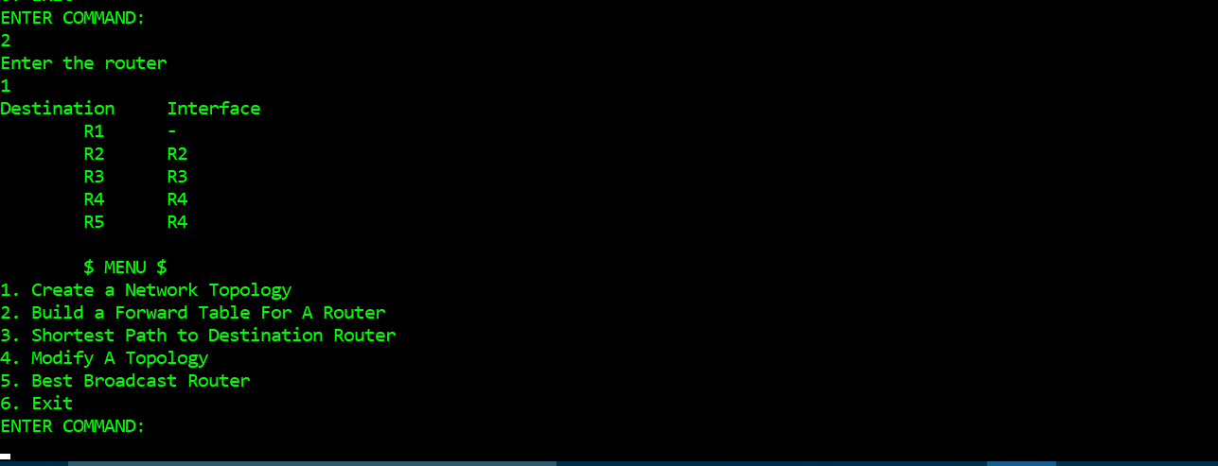
Displays forward table for each router

Slide 8
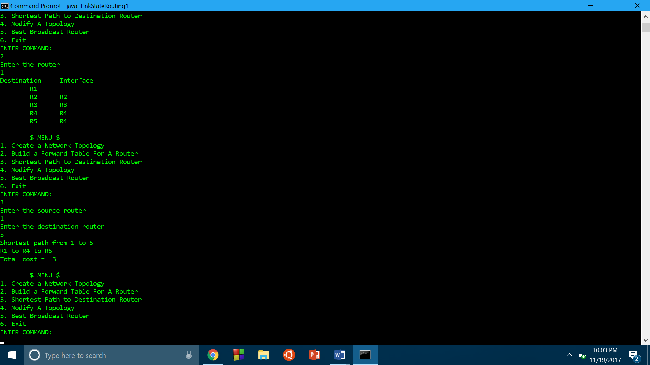
Calculates shortest path between any source and destination pair

Slide 9
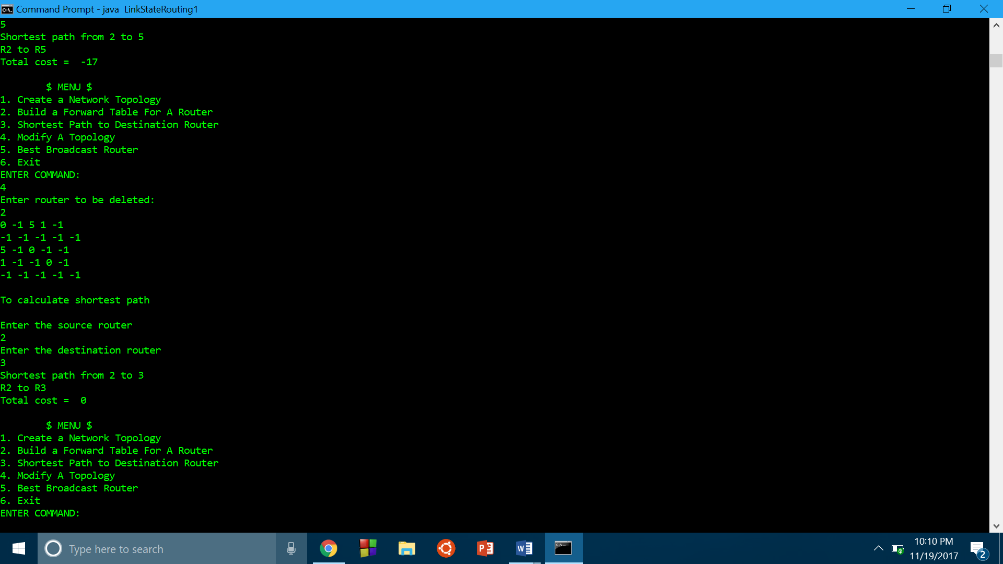
Modifies network topology

Slide 10
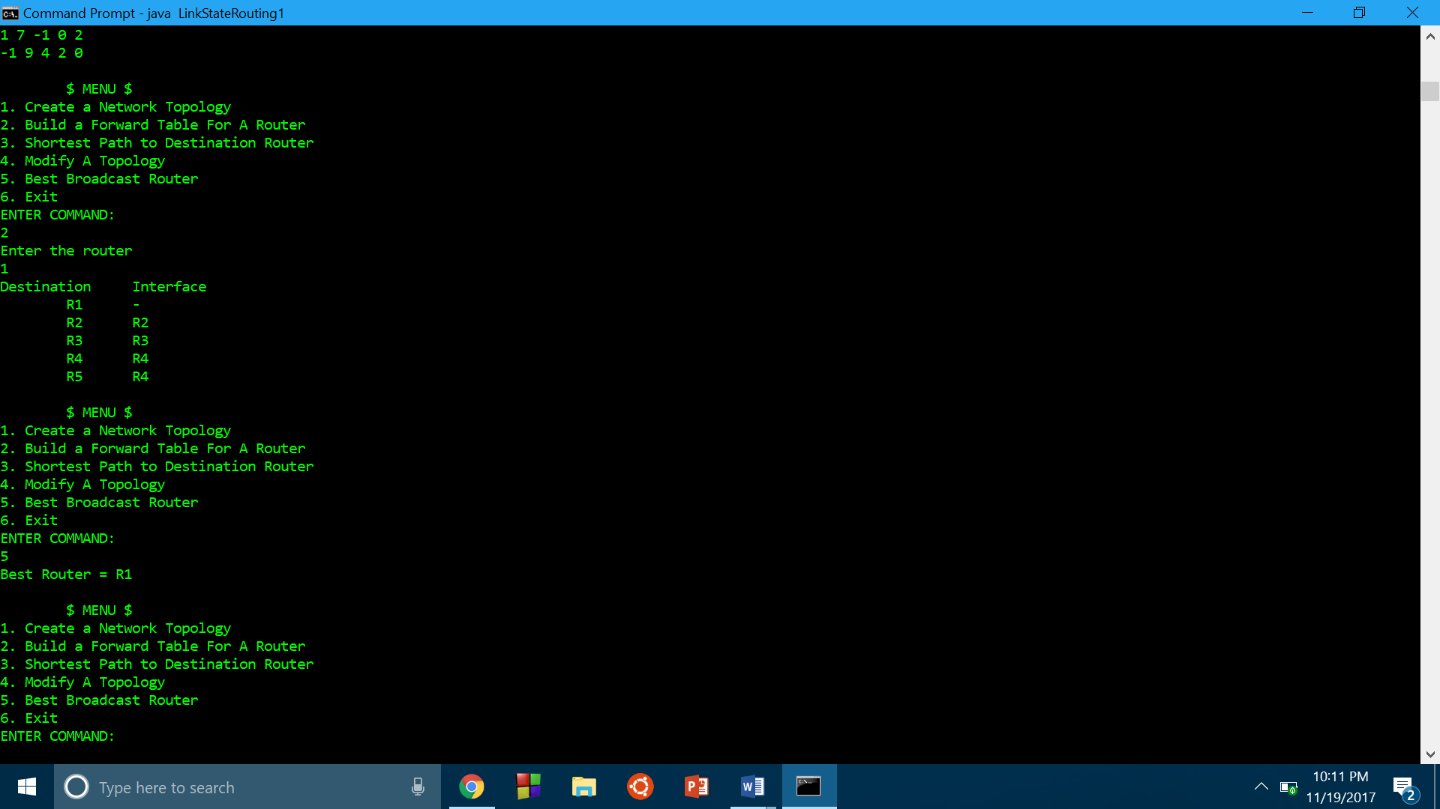
Calculates best broadcast router

Slide 11
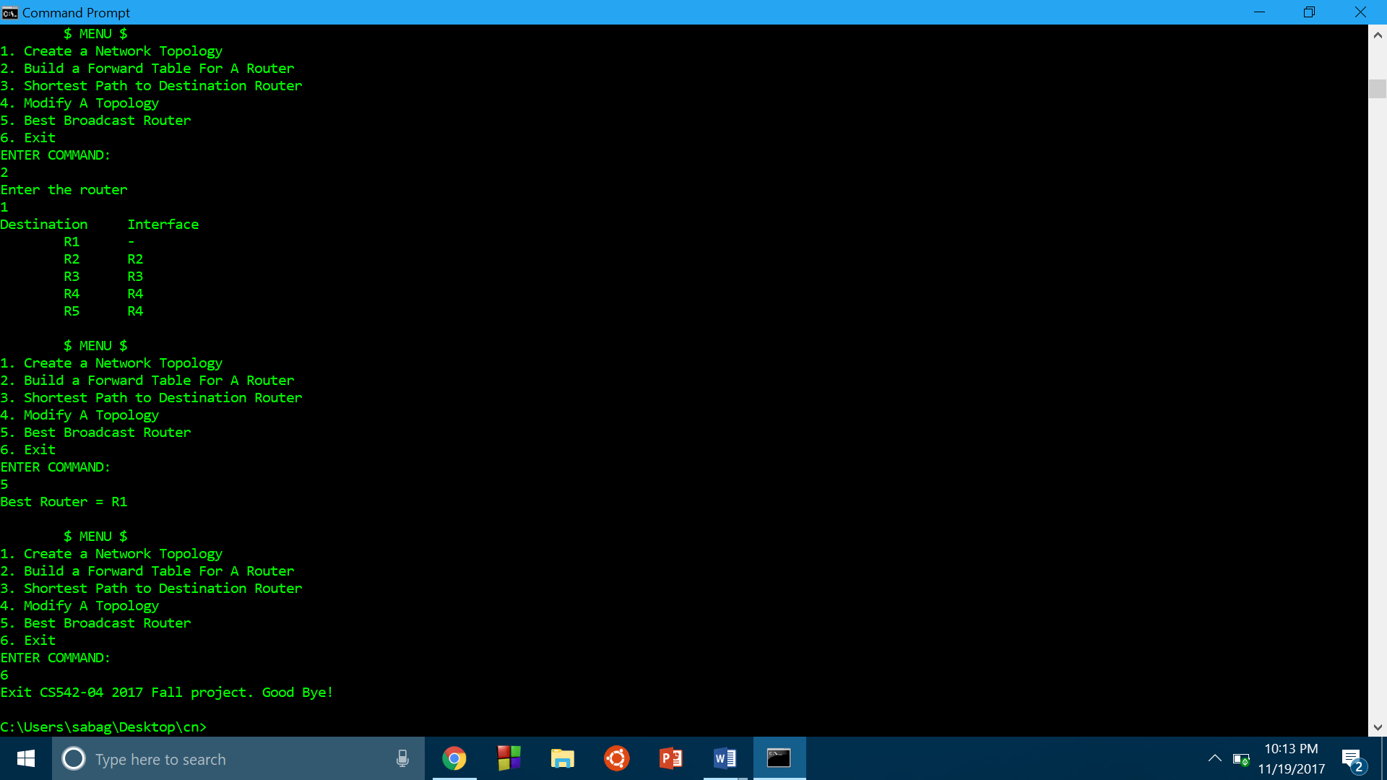
Exits the simulator on users choice

Slide 12
User manual
To run the link state routing simulator via command line prompt type java LinkStateRouting1
User can also use Eclipse or any other Java Compiler, import the Project and run its LinkStateRouting1.java file
Add the input network topology file in the same directory as the source code
In the input file, all the elements should be separated by single space
Enter the desired choice to get the required output

Slide 13
Thank you!!

